Slide 1
C-PROGRAMMING
TPE-004
Contact
svandamme@omnesintervenant.com

Slide 2
Table of content
TPE-004-1 | Introduction to Data and Variables
Understand what data is in programming and how C stores it using variables. Learn how to declare, initialize, and use variables in simple programs.
TPE-004-2 | Constants and Literals
Learn how to represent fixed values in programs and prevent changes to important data using constants.
TPE-004-3 | Operators and Expressions
Master the symbols that let you perform calculations and comparisons. Understand how C evaluates expressions.
TPE-004-4 | Input and Output (I/O) Basics
Use the standard input/output functions to interact with users. Learn how to display results and read user input.

Slide 3
TPE-004-1 | Introduction to Data and Variables
Understand what data is in programming and how C stores it using variables. Learn how to declare, initialize, and use variables in simple programs.
Variables
>
What’s a variable

Slide 4
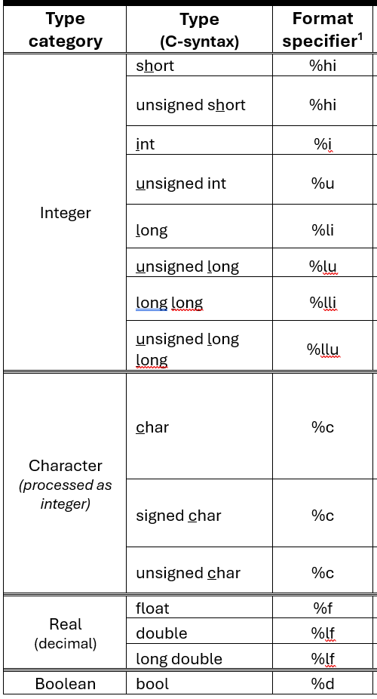
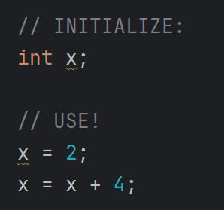

TPE-004-1 | Introduction to Data and Variables
Understand what data is in programming and how C stores it using variables. Learn how to declare, initialize, and use variables in simple programs.
Variables
>
Overview
How to set a variable?

Slide 5
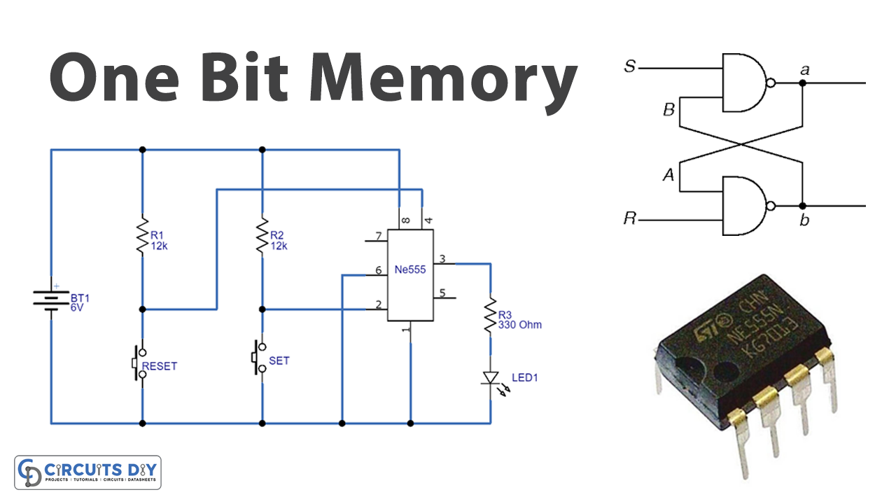
TPE-004-1 | Introduction to Data and Variables
Understand what data is in programming and how C stores it using variables. Learn how to declare, initialize, and use variables in simple programs.
Variables
>
A “bit” of memory…
A binary variable can have only two values:
Analogy with 4 decimal digits:
1
0
(X)10 =
(4 digits)
9
5
0
3
10
4
10
2
10
1
10
0
Multiplied by…
9000
500
00
3
Result per tile
Now, using multiple binary slot in the memory of the machine, we can code on multiple bits!
Total sum (in base-10): 9503
Coding in 4 bits:
(X)2 =
(4 bits)
1
1
1
0
3
2
1
0
2
2
2
2
Multiplied by…
8
4
2
0
Result per tile
Total sum (in base-10): 14

Slide 6
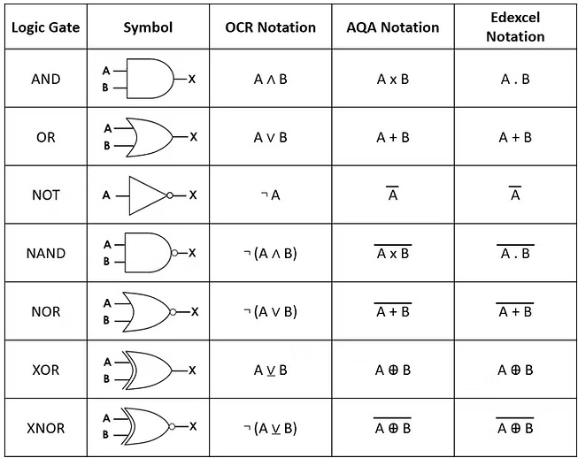
TPE-004-1 | Introduction to Data and Variables
Understand what data is in programming and how C stores it using variables. Learn how to declare, initialize, and use variables in simple programs.
Variables
>
Boolean algebra (1/2)

Slide 7
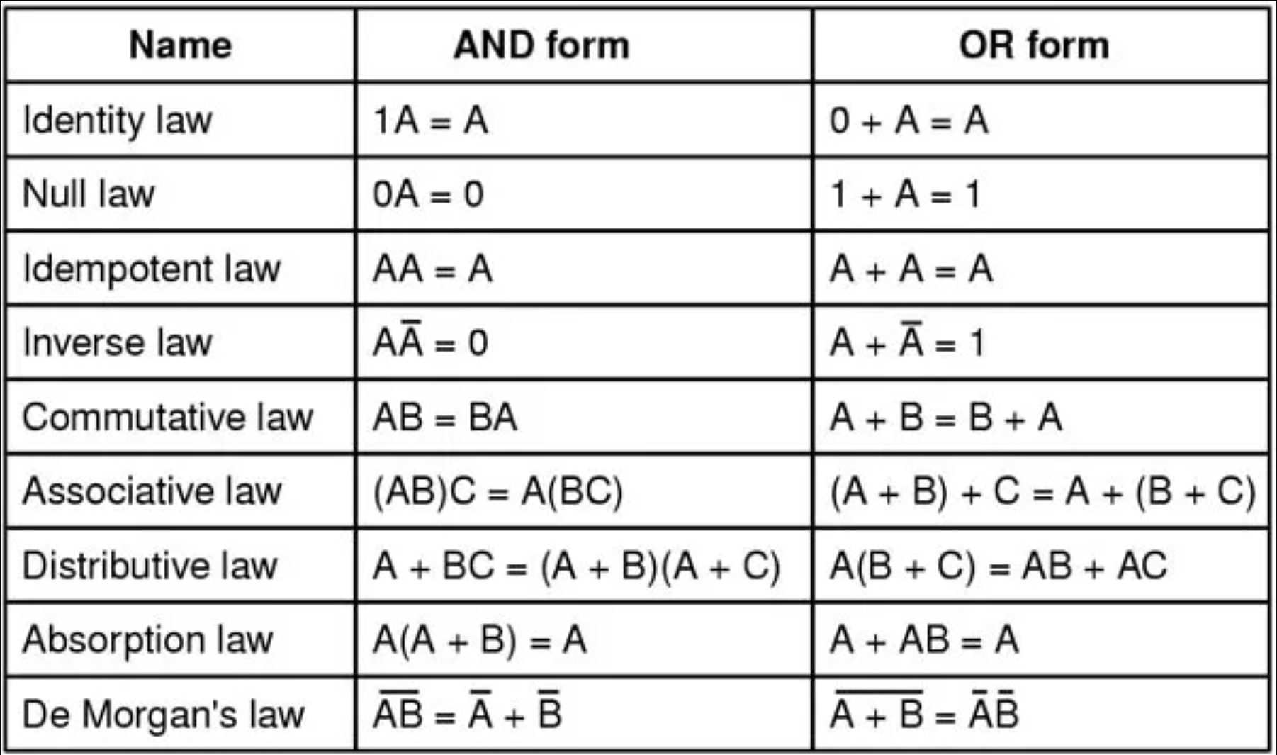
TPE-004-1 | Introduction to Data and Variables
Understand what data is in programming and how C stores it using variables. Learn how to declare, initialize, and use variables in simple programs.
Variables
>
Boolean algebra (2/2)

Slide 8
TPE-004-1 | Introduction to Data and Variables
Understand what data is in programming and how C stores it using variables. Learn how to declare, initialize, and use variables in simple programs.
Variables
>
Binary, octet, hexa…
An octet is a set of 8 bits put together.
A binary variable can have only two values:
0
1
A kilo-octet (ko) is NOT the same as a kilo-bit (kb)
A decimal variable can have up to 10 values per tile:
0
1
2
3
…
8
9
An hexadecimal variable can have up to 16 values per tile:
0
1
2
3
…
8
9
A
B
C
D
E
F
10
11
12
13
14
15

Slide 9
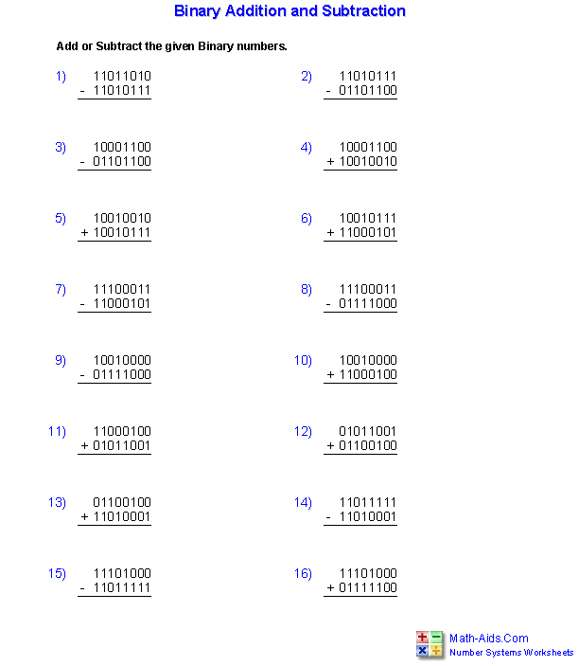
TPE-004-1 | Introduction to Data and Variables
Understand what data is in programming and how C stores it using variables. Learn how to declare, initialize, and use variables in simple programs.
Variables
>
Binary calculations

Slide 10
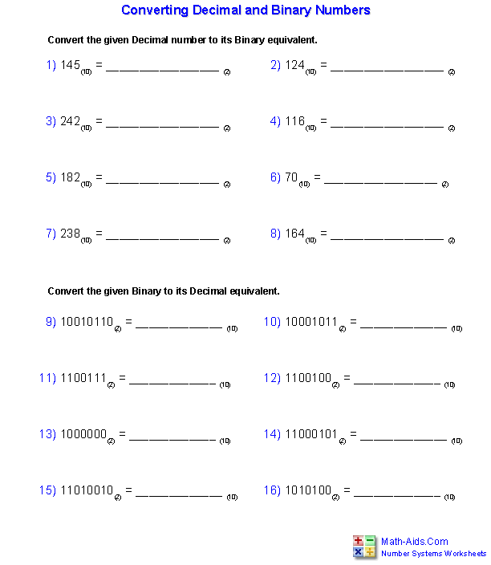
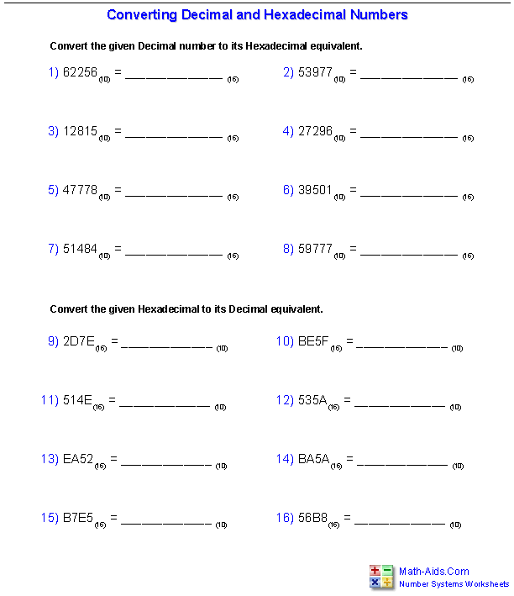
TPE-004-1 | Introduction to Data and Variables
Understand what data is in programming and how C stores it using variables. Learn how to declare, initialize, and use variables in simple programs.
Variables
>
Binary calculations

Slide 11
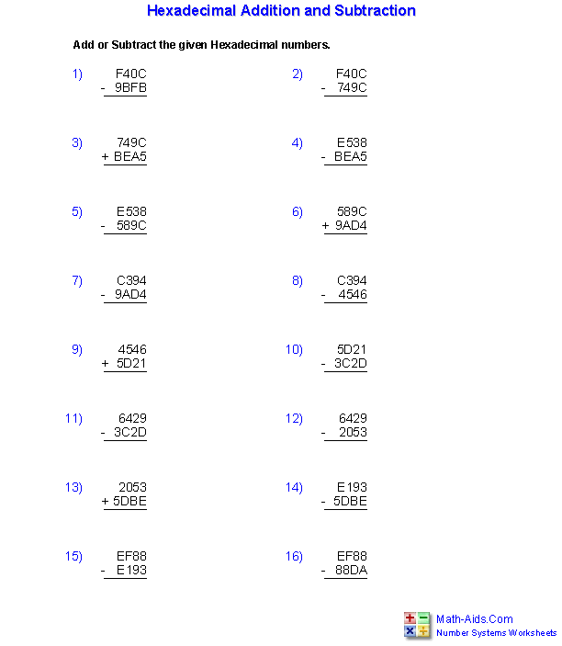
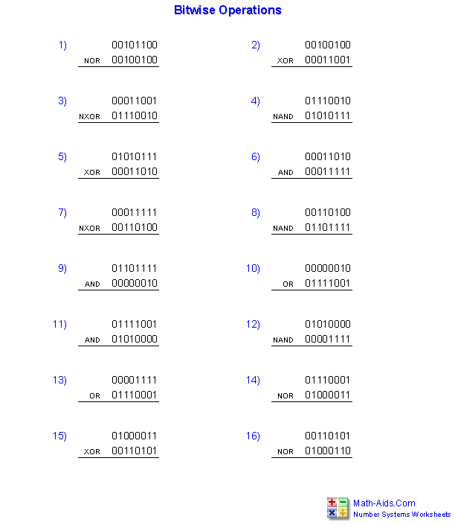
TPE-004-1 | Introduction to Data and Variables
Understand what data is in programming and how C stores it using variables. Learn how to declare, initialize, and use variables in simple programs.
Variables
>
Binary calculations

Slide 12
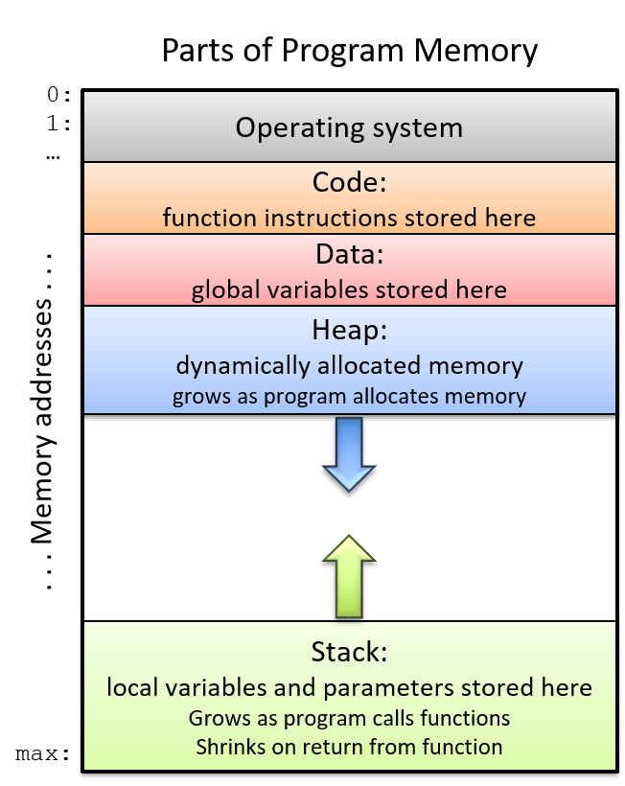
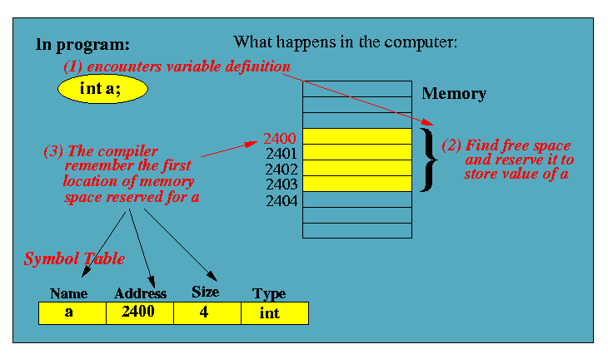
TPE-004-1 | Introduction to Data and Variables
Understand what data is in programming and how C stores it using variables. Learn how to declare, initialize, and use variables in simple programs.
Variables
>
A “bit” of memory…

Slide 13
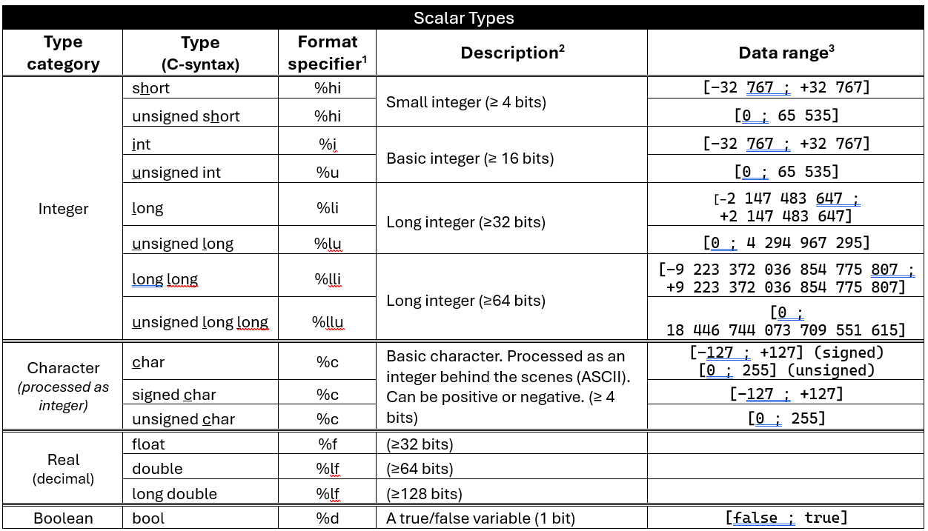
TPE-004-1 | Introduction to Data and Variables
Understand what data is in programming and how C stores it using variables. Learn how to declare, initialize, and use variables in simple programs.
Variables
>
Complete data types

Slide 14


TPE-004-1 | Introduction to Data and Variables
Understand what data is in programming and how C stores it using variables. Learn how to declare, initialize, and use variables in simple programs.
Variables
>
Range & bit precision
Bit attribution
The number of bit depends on your OS architecture! (32 bits – 64 bits)
Use this function to know how much bits are attributed to each variables.
Example:

Slide 15

TPE-004-1 | Introduction to Data and Variables
Understand what data is in programming and how C stores it using variables. Learn how to declare, initialize, and use variables in simple programs.
Variables
>
Naming convention in C (1/2)
5 RULES!
Restricted to letters, digits and underscore ("_") hello_world, helloWorld...
Must NOT starts by a digit 1dog, 2dog …
“Case-sensitive”: watch out for capitalized letters (score =/= Score)
Don’t use keywords from C int, return …
Keep it short and concise (maximum 31 letters)
Constant variables
Write in ALL_CAPS_WITH_UNDERSCORES.

Slide 16
TPE-004-1 | Introduction to Data and Variables
Understand what data is in programming and how C stores it using variables. Learn how to declare, initialize, and use variables in simple programs.
Variables
>
Naming convention in C (2/2)
Naming convention
camelCase
snake_case
userName
totalPrice
fishDistributionResult
user_name
total_price
fish_distribution_result
Name them CLEARLY
The variable name must be as indicative as possible, so that everyone know how and why to use your variables.
farenhS1 ➔ sensorFarenheit_1

Slide 17
TPE-004-2 | Constants and Literals
Learn how to represent fixed values in programs and prevent changes to important data using constants.
Constants & Literals
>
"const"

Slide 18
TPE-004-2 | Constants and Literals
Learn how to represent fixed values in programs and prevent changes to important data using constants.
Constants & Literals
>
"#define"

Slide 19
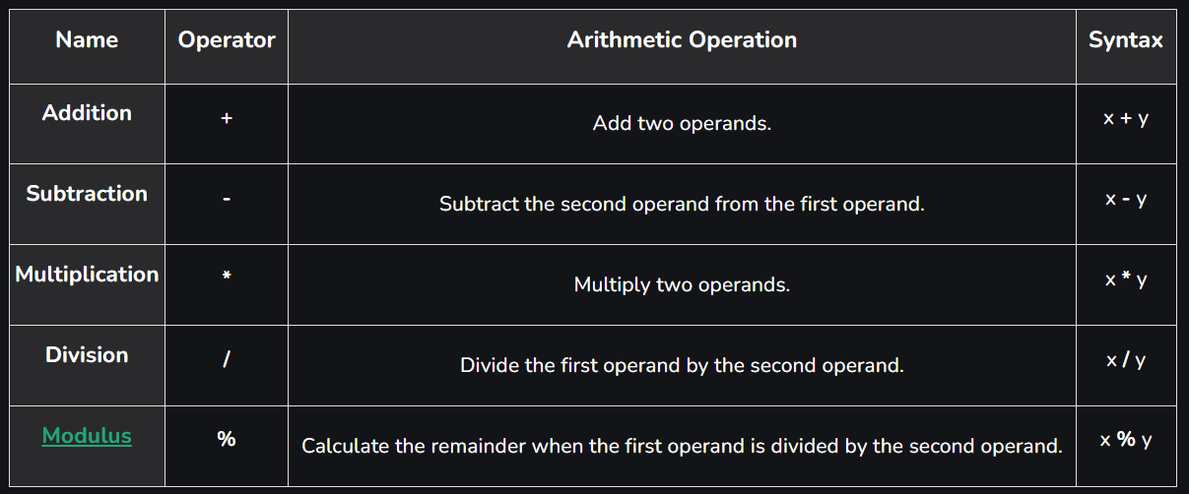
TPE-004-3 | Operators and Expressions
Master the symbols that let you perform calculations and comparisons. Understand how C evaluates expressions.
Operators and Expressions
>
Arithmetic operators
Tips
You can use “++” and “--” to update a value with +/- 1 easily.

Slide 20
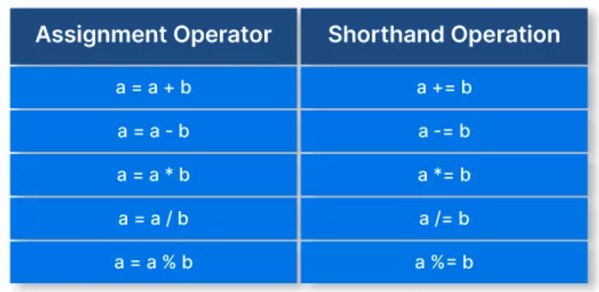
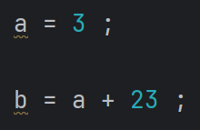
TPE-004-3 | Operators and Expressions
Master the symbols that let you perform calculations and comparisons. Understand how C evaluates expressions.
Operators and Expressions
>
Assignment
Default
Advanced

Slide 21
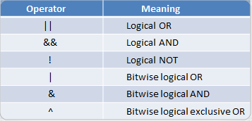
TPE-004-3 | Operators and Expressions
Master the symbols that let you perform calculations and comparisons. Understand how C evaluates expressions.
Operators and Expressions
>
Logical operators / Comparison

Slide 22
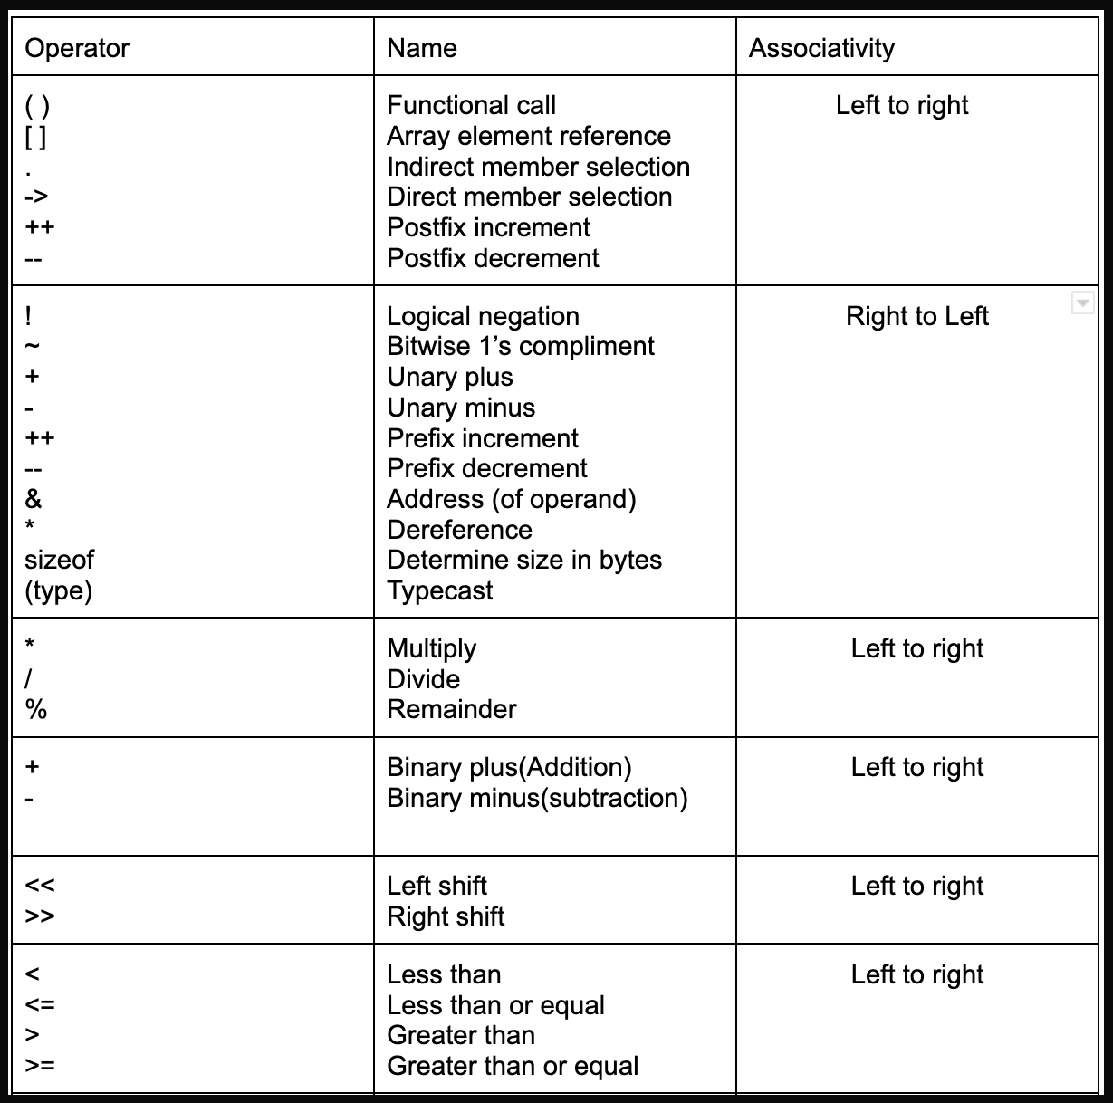
TPE-004-3 | Operators and Expressions
Master the symbols that let you perform calculations and comparisons. Understand how C evaluates expressions.
Operators and Expressions
>
Precedence and associativity

Slide 23
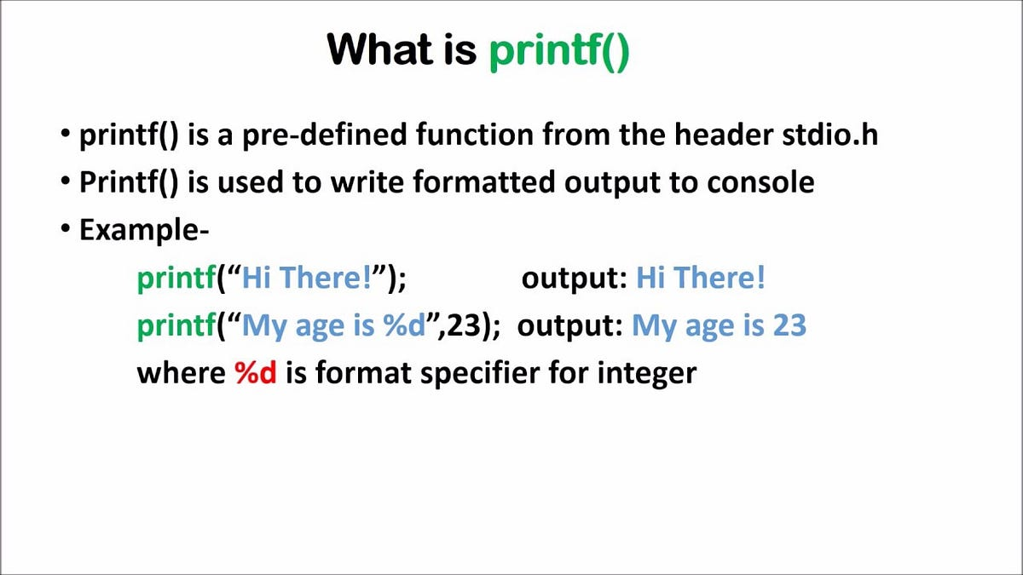
TPE-004-4 | Input and Output (I/O) Basics
Use the standard input/output functions to interact with users. Learn how to display results and read user input.
Input and Output (I/O) Basics
>
printf()

Slide 24
TPE-004-4 | Input and Output (I/O) Basics
Use the standard input/output functions to interact with users. Learn how to display results and read user input.
Input and Output (I/O) Basics
>
printf()

Slide 25
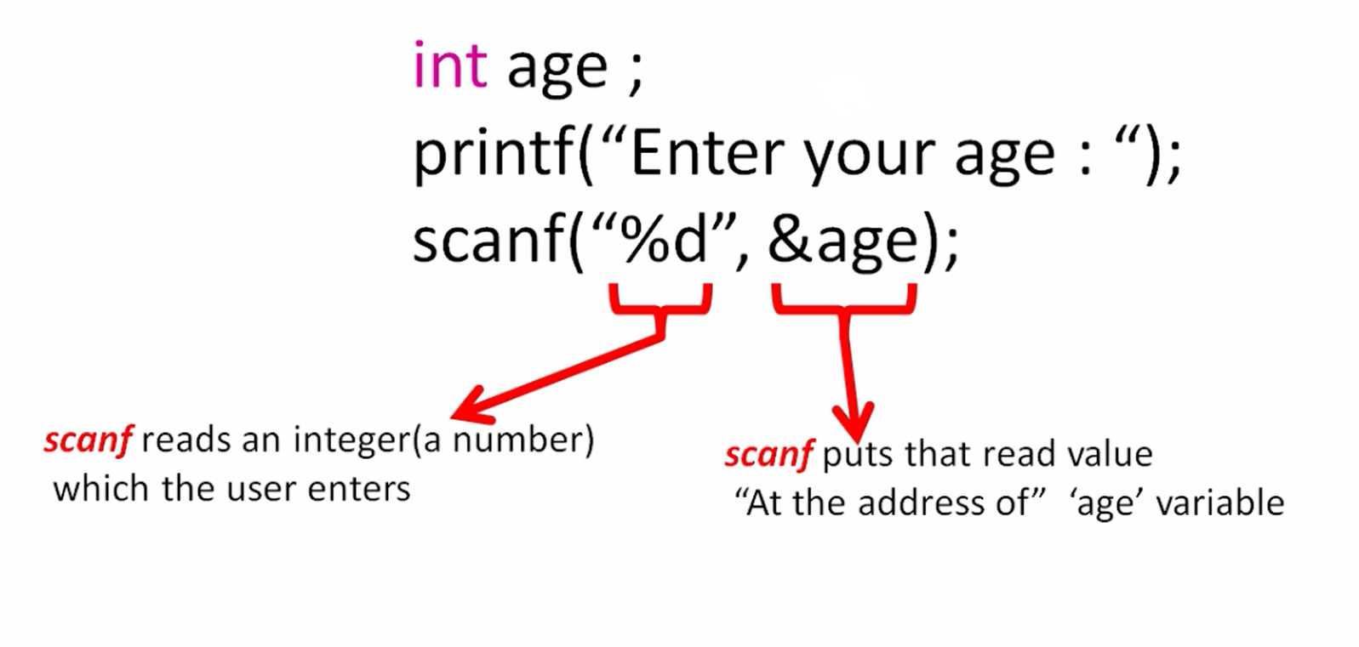
TPE-004-4 | Input and Output (I/O) Basics
Use the standard input/output functions to interact with users. Learn how to display results and read user input.
Input and Output (I/O) Basics
>
scanf()

